Slide 1
SAP BTP Extension Suite Training
Day 13
Anubhav Oberoy
www.AnubhavTrainings.com
Follow excellence with sheer passion

Slide 2


DISCLAIMER
The training content and delivery of this presentation is confidential, and cannot be recorded, or copied and distributed to any third party, without the written consent of Anubhav Trainings

Slide 3
Agenda – Day 13
01
Authentication v/s Authorization
02
XSUAA
03
Adding Security

Slide 4
Authentication v/s Authorization
Authentication – It ensures that is our user a valid user? Has he/she entered valid credentials to login to our app. It is enforced by a login screen. This login screen can also come from IDP like SSO, LDAP, Social integration.
Authorization – Once user is authentication, then the authorization comes into play. It ensures, is our user allowed to do certain activities inside app. What is the level of access. E.g. create, update, delete, approve, view.
SAP BTP cf environment has a special component called XSUAA –
XS – eXtended Services
UAA – User Account and Authorization
This is an in-built component inside of CF
It is responsible to control the user account and authorization
It manages our application security
In CF we use modular approach to address security
As a developer we need to decide what roles and level of security we need in our app. Example, we need to secure odata resource /Anubhav.svc
Usually we define Viewer, Editor
We need to define our scope and role templates inside a special file called xs-security.json file
XSUAA Communicates to the IDP – Identity Provider
Issues JWT (JSON web Token) to cloud foundry router which let user access the app based on permission.
Scope
(permission)
* *
Role Template
* *
Role Collection

Slide 5

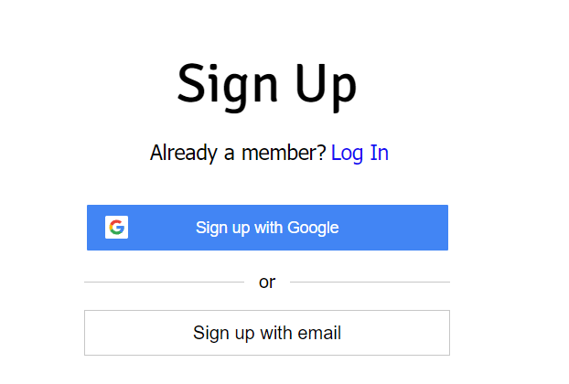

IDP – Identity Provider
An identity provider is a software or group of software which stores all the user credentials and their scopes (roles) in itself. This will centralize the user management in company and simplify the login process to different apps. This way user do not need to remember multiple passwords to multiple apps.
Portal
Launchpad
Dedicated SRM
SSO
SAP Server
GSuite
LDAP
User/email/password
Single source of truth
Trust relation
Scope- clerk, manager, ceo
Outlook
Our cloud app
xsuaa
XSUAA

Slide 6
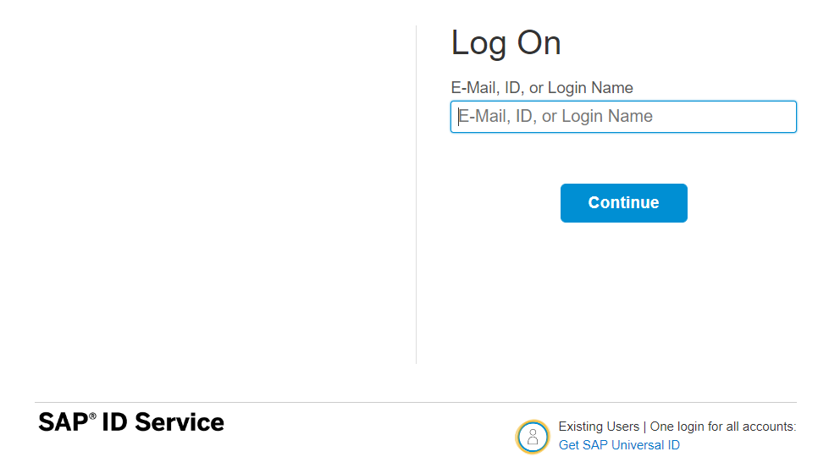






How it works behind scenes
xs-security.json contains information which we need to register to define what are all permissions required in our app
code
JWT
App
Browser
postman
ourxsuaa
trust
JWT
XSUAA
Scope
SAML
trust
IdP

Slide 7























Slide 8


















































Runtime

Slide 9

Hands-on Add Security and Test Microservice
cds add xsuaa

Slide 10
Authentication v/s Authorization
Authentication – It ensures that is our user a valid user? Has he/she entered valid credentials to login to our app. It is enforced by a login screen. This login screen can also come from IDP like SSO, LDAP, Social integration.
Authorization – Once user is authentication, then the authorization comes into play. It ensures, is our user allowed to do certain activities inside app. What is the level of access. E.g. create, update, delete, approve, view.
SAP BTP cf environment has a special component called XSUAA –
XS – eXtended Services
UAA – User Account and Authorization
This is an in-built component inside of CF
It is responsible to control the user account and authorization
It manages our application security
In CF we use modular approach to address security
As a developer we need to decide what roles and level of security we need in our app. Example, we need to secure odata resource /Anubhav.svc
Usually we define Viewer, Editor
We need to define our scope and role templates inside a special file called xs-security.json file
XSUAA Communicates to the IDP – Identity Provider
Issues JWT (JSON web Token) to cloud foundry router which let user access the app based on permission.
Scope
(Role)
* *
Role Template
* *
Role Collection

Slide 11
IDP – Identity Provider
An identity provider is a software or group of software which stores all the user credentials and their scopes (roles) in itself. This will centralize the user management in company and simplify the login process to different apps. This way user do not need to remember multiple passwords to multiple apps.
Portal
Launchpad
Dedicated SRM
SSO
SAP Server
GSuite
LDAP
User/email/password
Single source of truth
Trust relation
Scope- clerk, manager, ceo
Outlook
Our cloud app
xsuaa
XSUAA

Slide 12

What We Did
Let’s Summarize

Slide 13

www.anubhavtrainings.com
Thank You
End of Day 6

Slide 14


We’re committed to empower you to be
#FutureReady
through powerful training solutions.
We build the workforce of the future.
260+
Corporate Clients
60,000+
Learners Trained
26000+
Learners Placed
FREE WEBINARS
Sign up for free webinars with industry experts every fortnight!
Enroll Now!
Contact us today!
https://anubhavtrainings.com

